Slide 1
ETL MLB Weather Project
Jie Feng
Riley Williamson
Nick Ayvazian
Chiidozie Nwagbo
Wei Wu

Slide 2
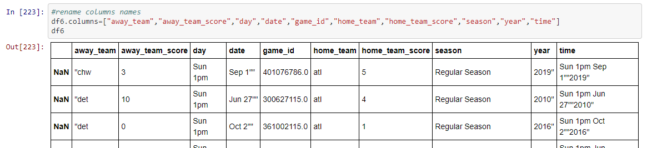
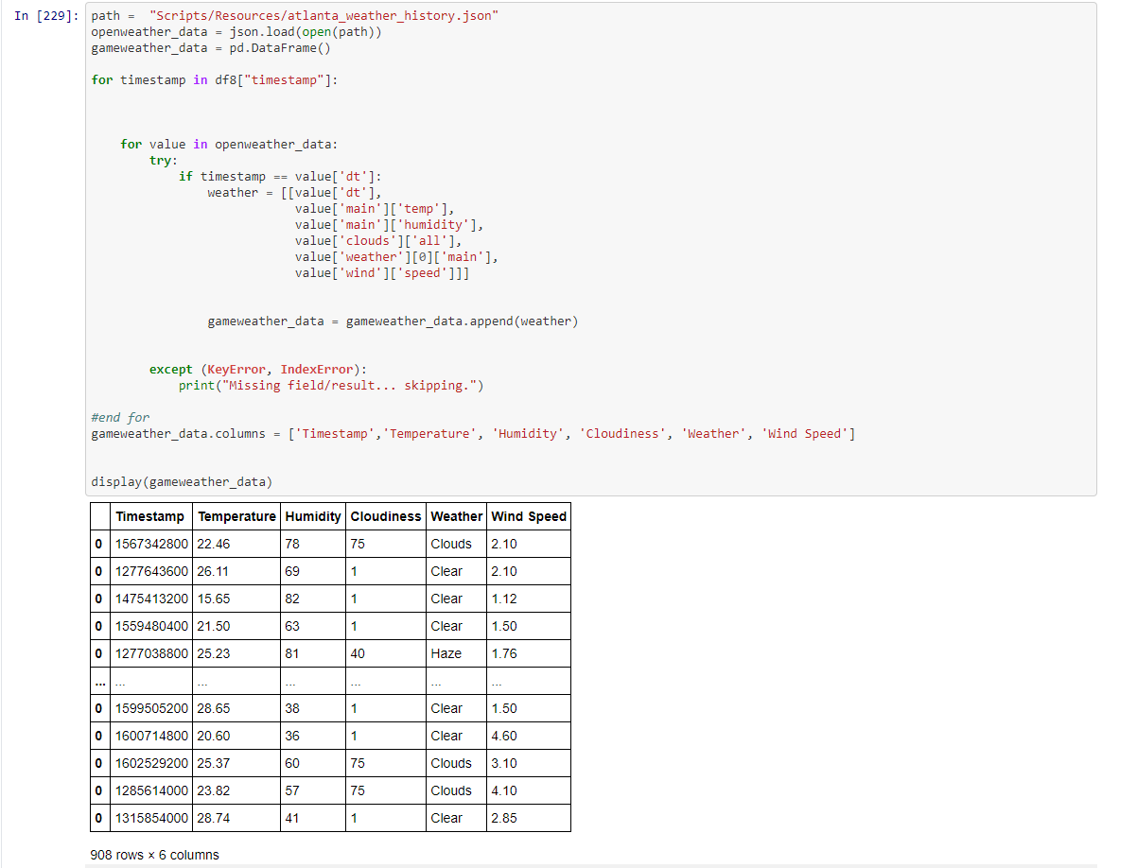
Extract:
We extracted the MLB Game Data from Kaggle from 2010 to 2020.
We extracted the data as a CSV file and were able to read it into a dataframe.
The weather data came from OpenWeather in a JSON format.

Slide 3
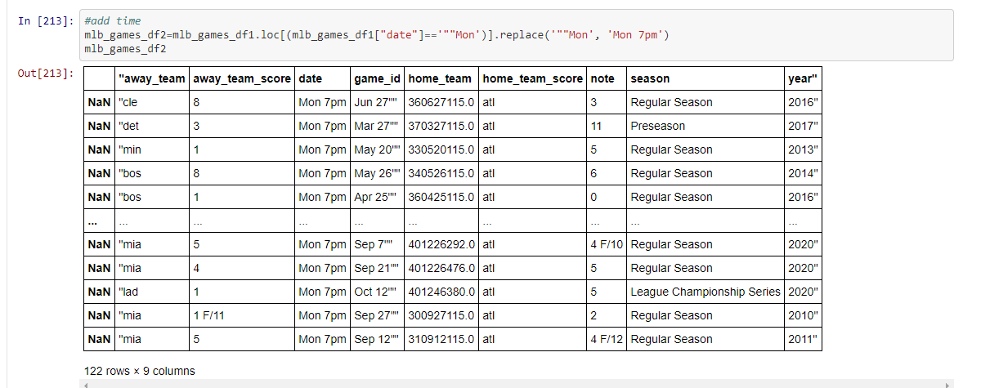
Transform
We cleaned the MLB data first. We filtered the home team column data to only show games in Atlanta and to remove any data from Preseason games.
Next, we added a time to every game: 7pm for weekday games and 1pm for weekend games.

Slide 4
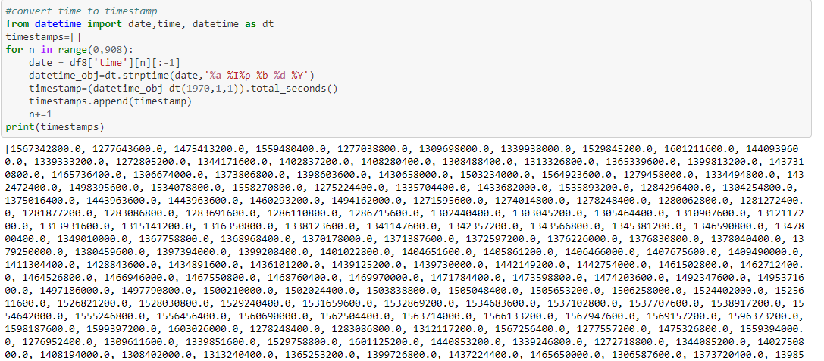
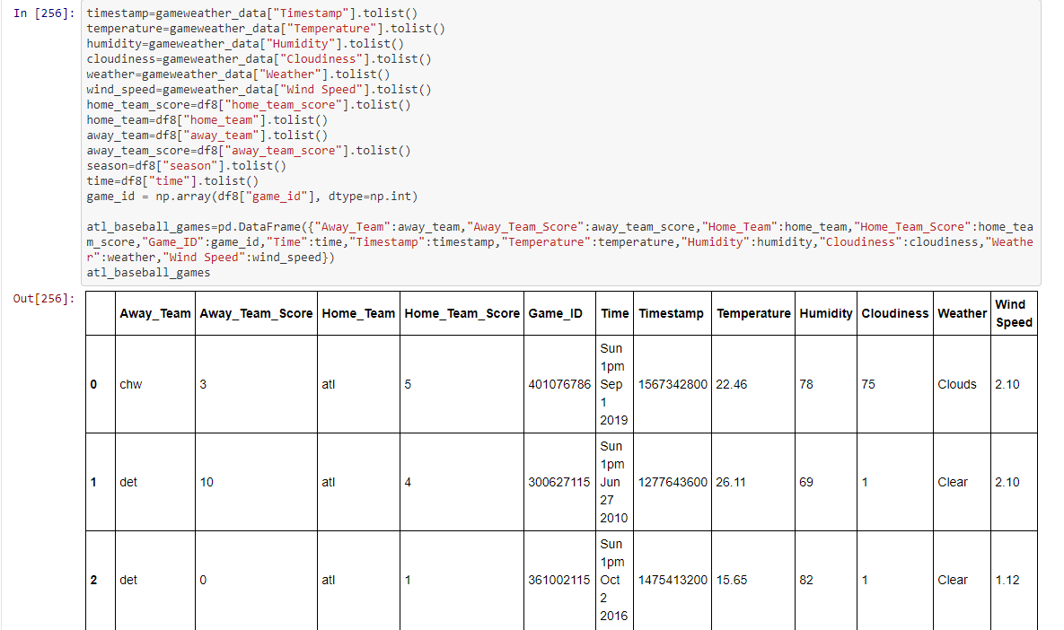
Transform
We converted game times to timestamps and added a timestamp column.
Next, we worked on transforming the weather data. From this JSON, we pulled data from the game timestamps and created a dataframe
The final step in transforming was to combine the two dataframes based on the shared timestamps.

Slide 5
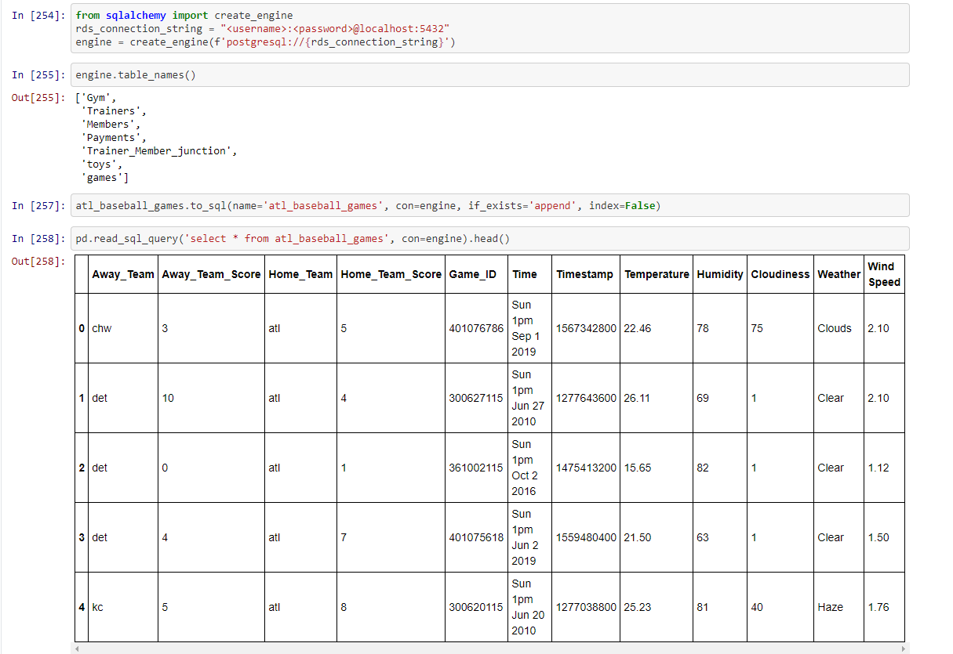
Load
After that we used SQLAlchemy to create an engine. We then loaded the data to a SQL final production database.
One combined table went into the database with the following columns: Away_Team, Away_Team_Score, Home_Team, Home_Team_Score, Game_ID, Time, Timestamp, Temperature, Humidity, Cloudiness, Weather, Wind_Speed.
We chose to use a Sql database because it was more organized and easier to edit.

